Slide 1
Data Visualization

Slide 2
Data Visualization and Insights
Data Visualization : Visual analytics is the representation and presentation of data that exploits our visual perception abilities in order to amplify cognition
Insights : Insight is the discovery of non-trivial, complex, deep, unexpected, or relevant truths about the information

Slide 3
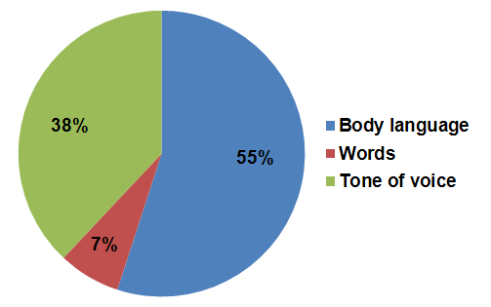
Importance of Data Visualization
7% – 38% – 55% rule
7% of the message is conveyed by the words
they use, 38% is conveyed by tone of voice
and 55% by body language or facial expression
Notes:
https://www.jisc.ac.uk/guides/influencing-others/message-and-medium

Slide 4
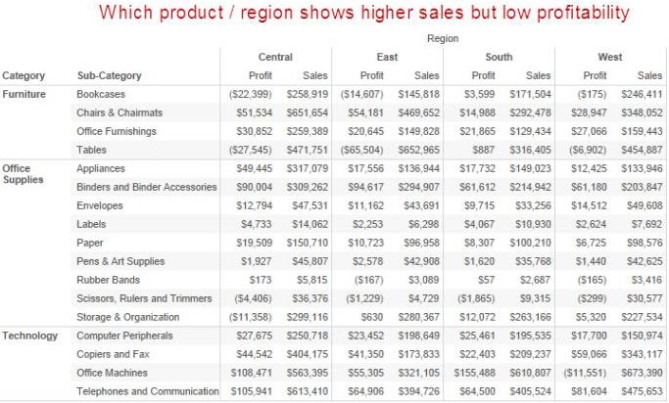
Importance of Data Visualization
Which product has the highest sales?

Slide 5
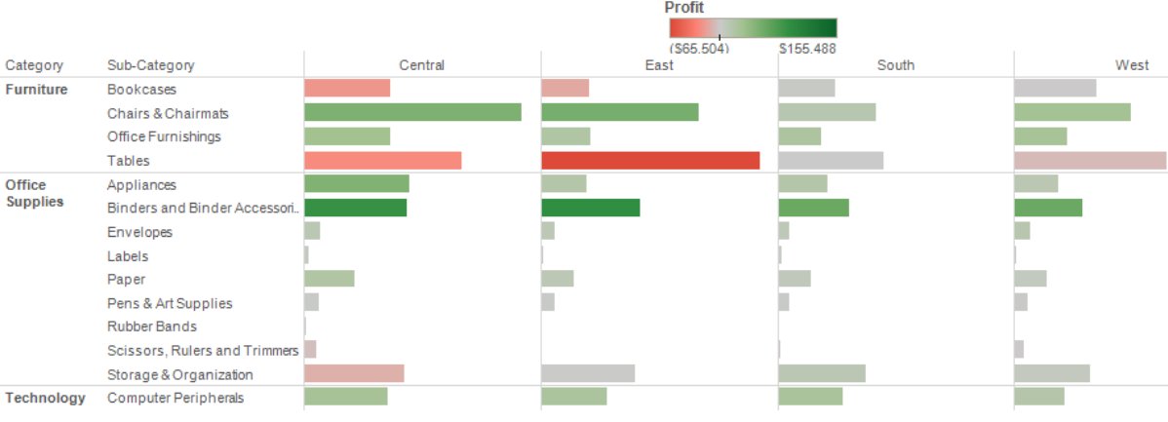
Importance of Data Visualization
Now Answer !!

Slide 6
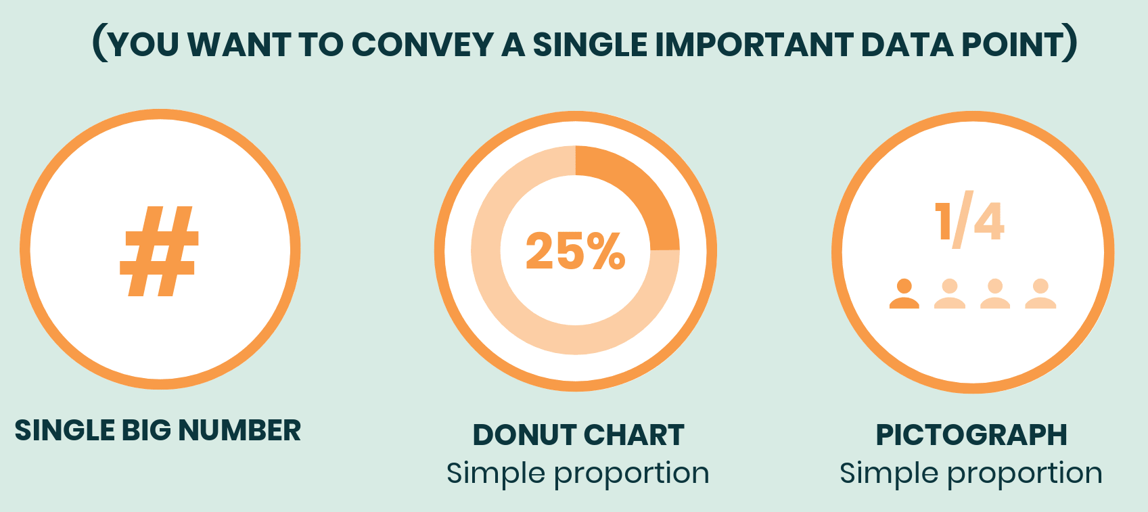
Choosing Charts based on Business Purpose
Display Single Figure
Notes:
https://venngage.com/blog/how-to-choose-the-best-charts-for-your-infographic/

Slide 7
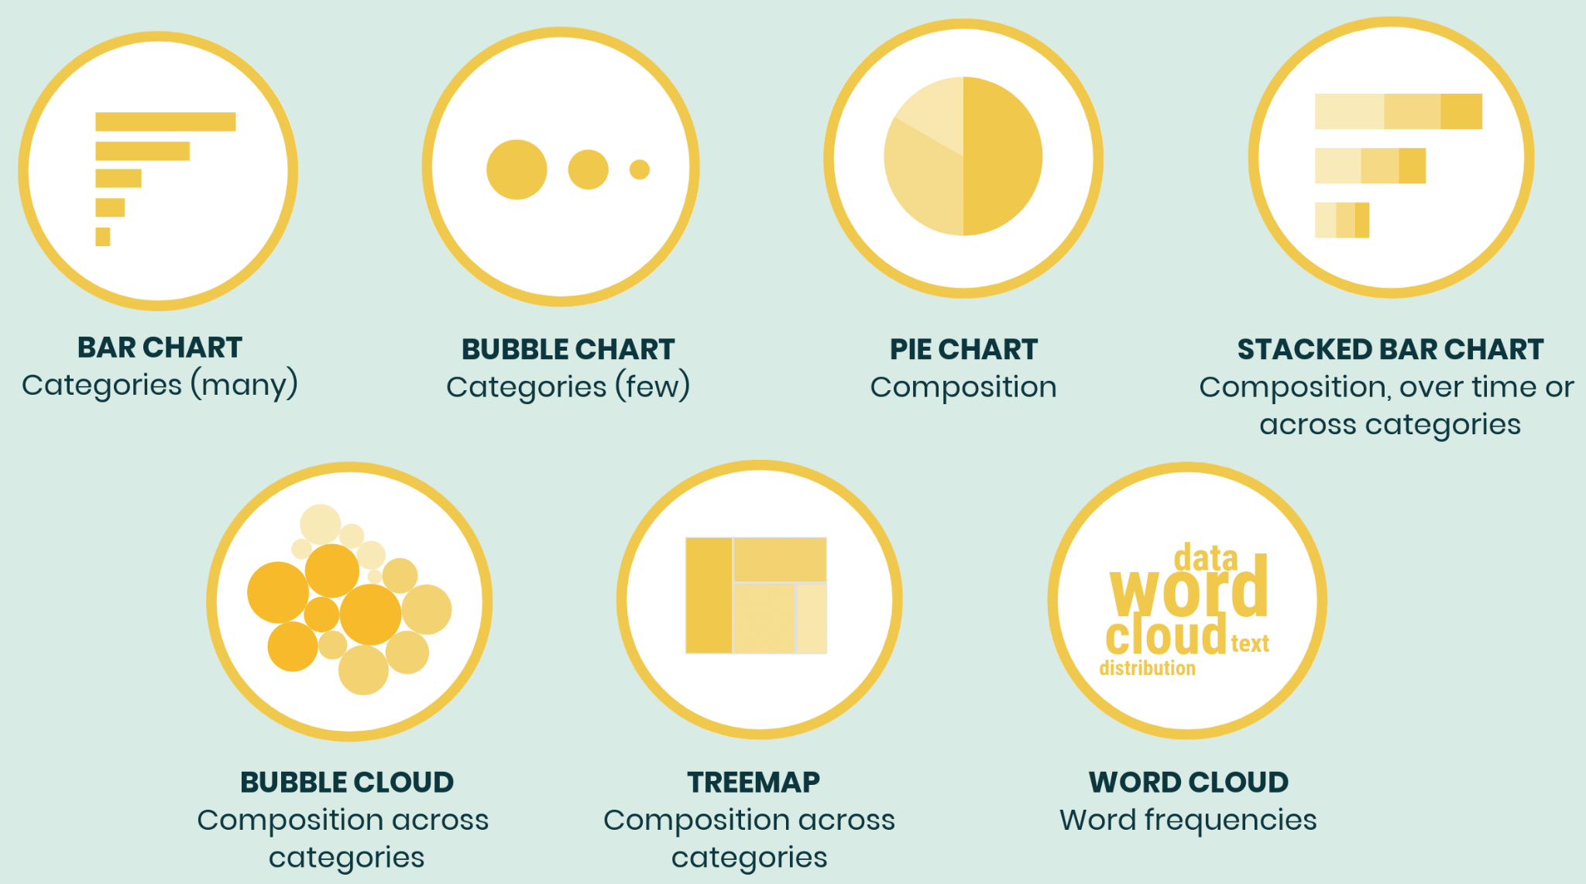
Choosing Charts based on Business Purpose
Compare
Notes:
https://venngage.com/blog/how-to-choose-the-best-charts-for-your-infographic/

Slide 8
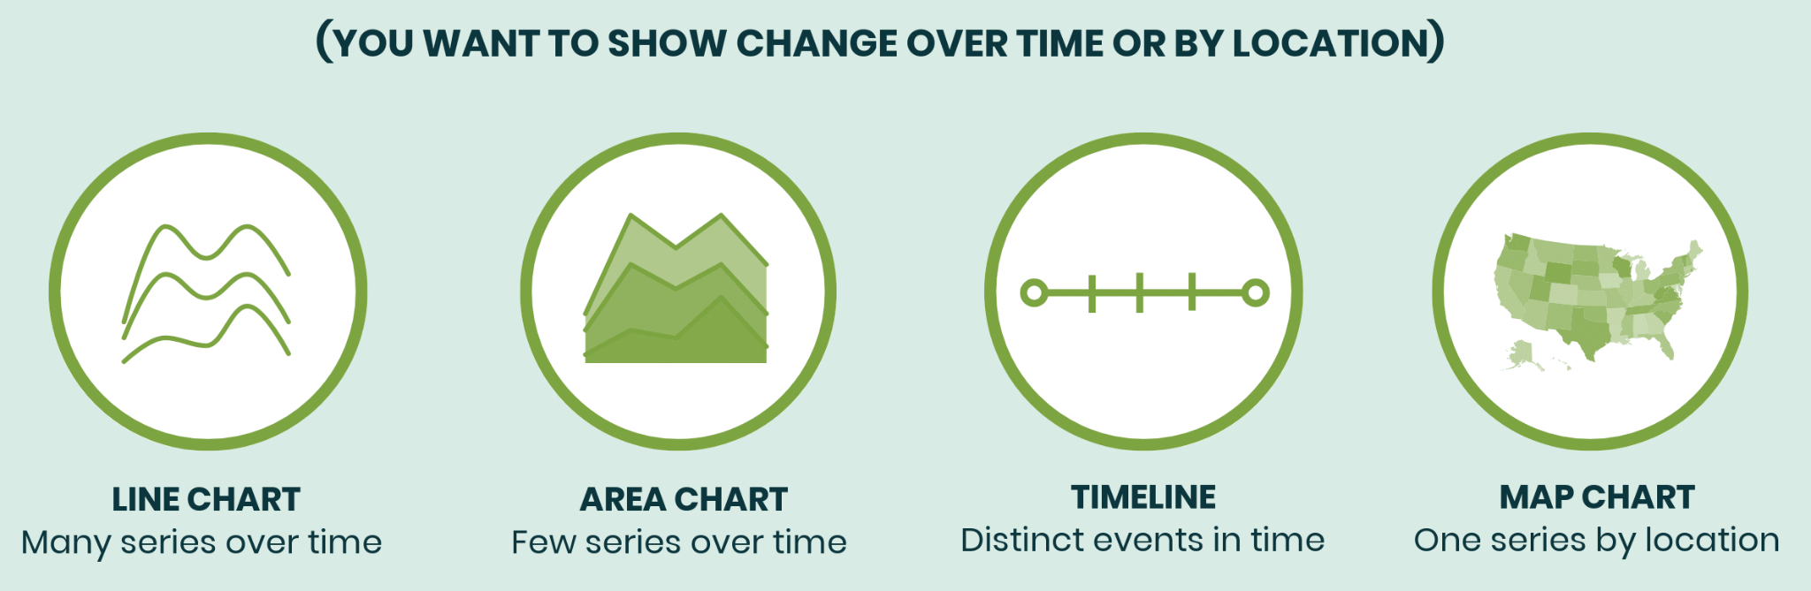
Choosing Charts based on Business Purpose
Change
Notes:
https://venngage.com/blog/how-to-choose-the-best-charts-for-your-infographic/

Slide 9
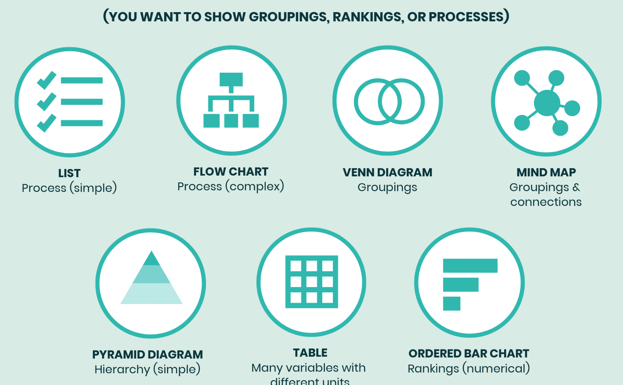
Choosing Charts based on Business Purpose
Organize
Notes:
https://venngage.com/blog/how-to-choose-the-best-charts-for-your-infographic/

Slide 10
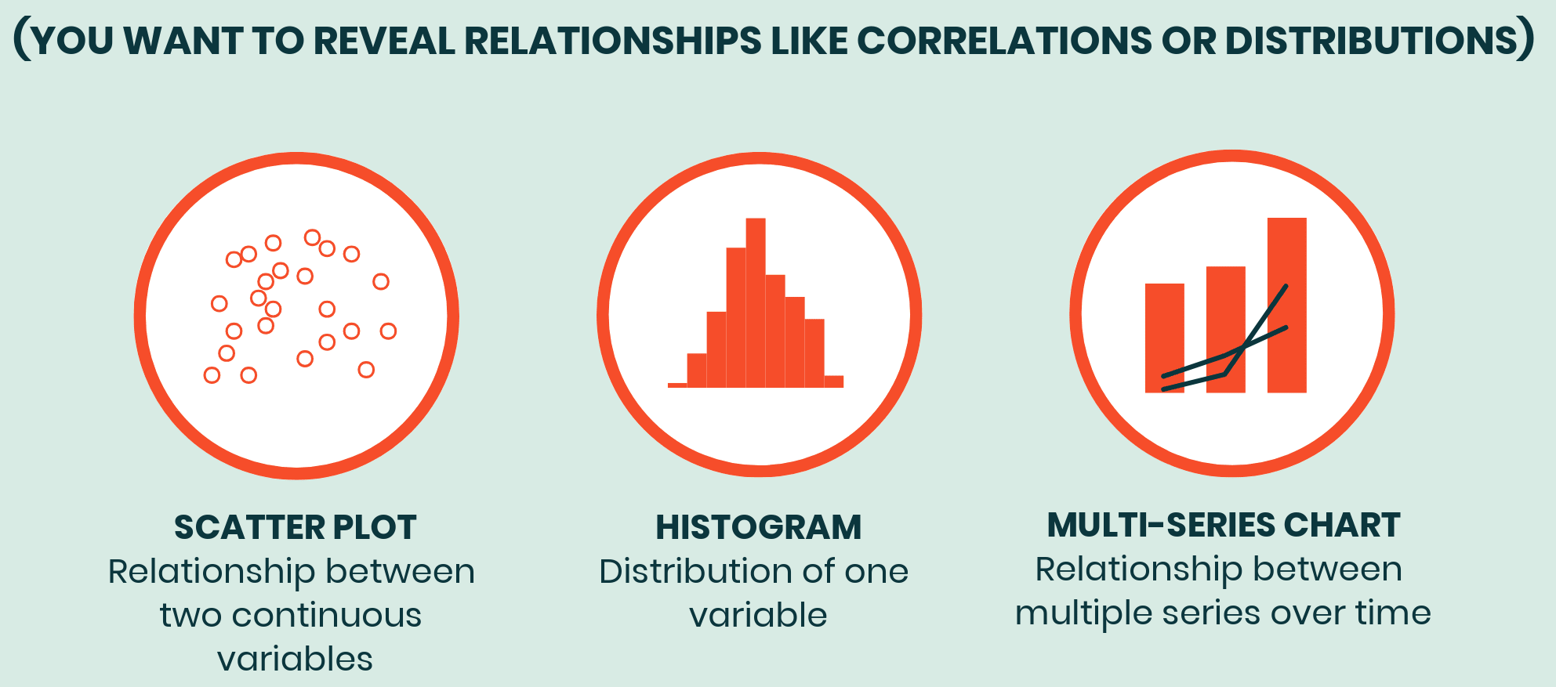
Choosing Charts based on Business Purpose
Relationship
Notes:
https://venngage.com/blog/how-to-choose-the-best-charts-for-your-infographic/

Slide 11
Measures and Dimensions
Measures | Dimensions
Numerical | Categorical
Quantitative | Qualitative
values that mathematical functions work on | dimension is what you “slice and dice” the number by.
E.g. sales , revenue, income, population, cost | E.g. Departments, country, Gender, Type of products

Slide 12
Choosing Charts based on Data Type
One Measure + One Dimension
One Measure + One Measure
One Measure
Date + 1 Measure
Distribution –2 Measures + 1 Dimension(Tree Map)

Slide 13
Choosing Charts based on Data Type
One Measure + One Dimension
Business Stories :
Compare (High / Low)
Rank (Organize)
Part to Whole
Common Plots :
Bar Plot
Heat Map (Distribution)

Slide 14
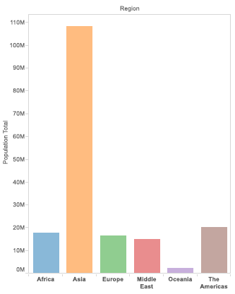
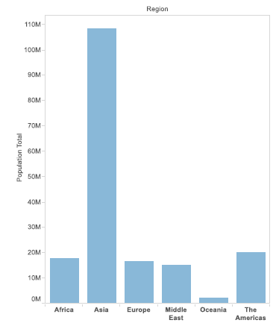
Bar Plot

Slide 15
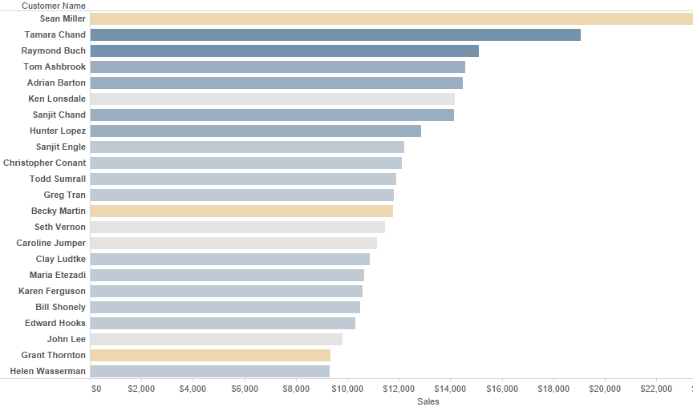
Bar Plot

Slide 16
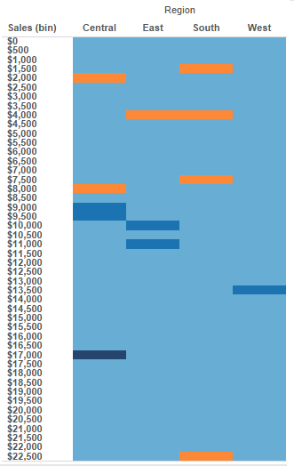

Heat Plot

Slide 17
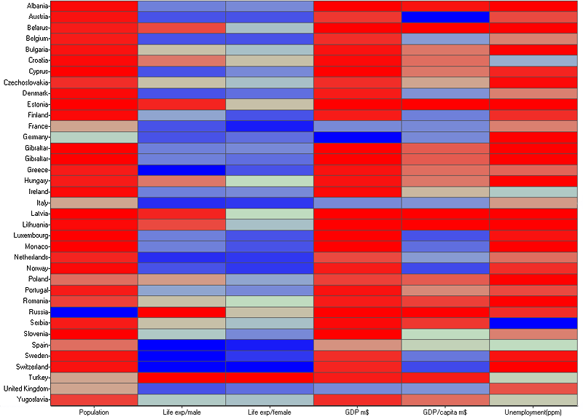
Heat Plot

Slide 18
Choosing Charts based on Data Type
One Measure + One Measure
Business Stories :
Trend
Concentrations
Gaps
Outliers
Groups/Clusters
Relationship
Common Plots :
Scatter Plot

Slide 19
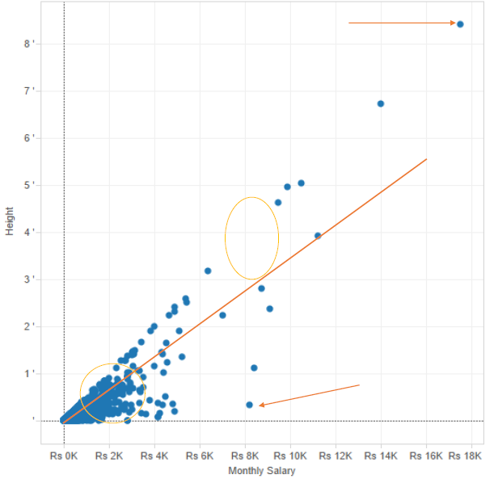
Scatter plot

Slide 20
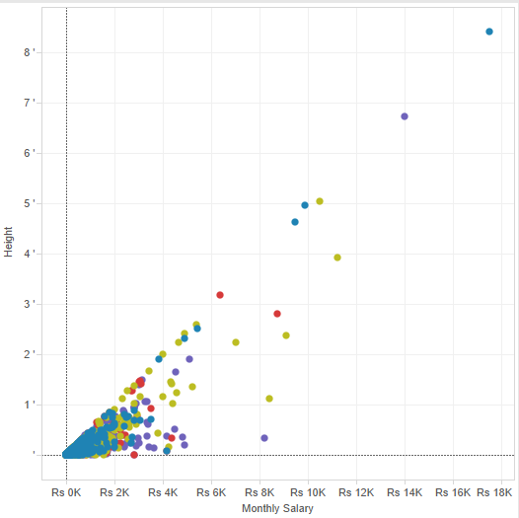

Scatter Plot

Slide 21
Choosing Charts based on Data Type
One Measure
Business Stories :
Distribution
Intervals
Grouping
Outliers
Categorize
Part to Whole –Intuitive
Range
Common Plots :
Histogram
Box Plot
Pie Chart

Slide 22
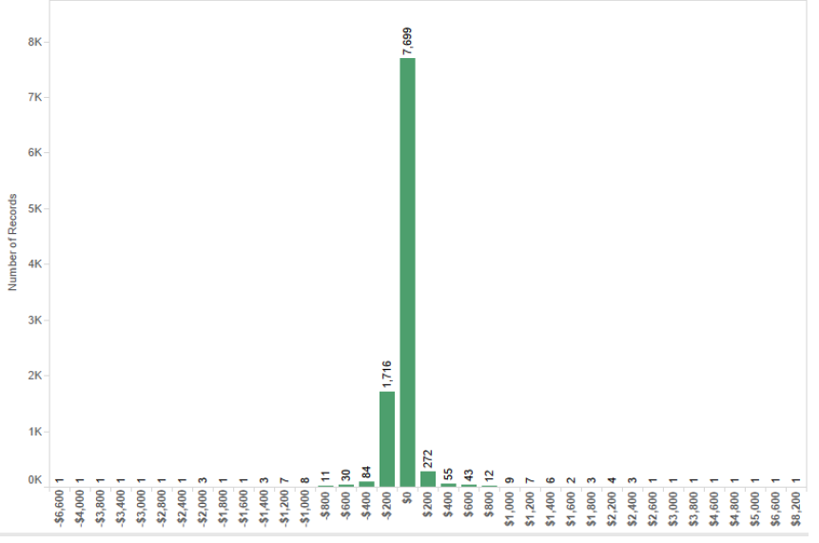
Histogram

Slide 23
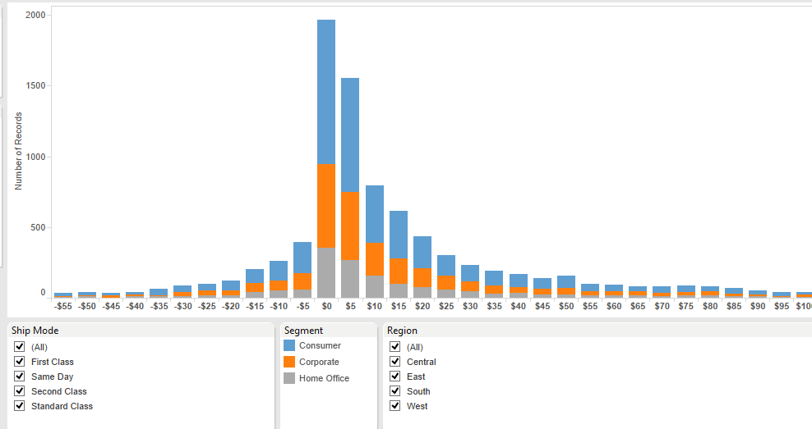
Histogram

Slide 24
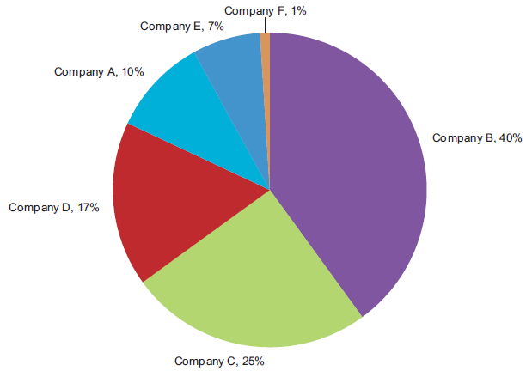
Pie Chart

Slide 25
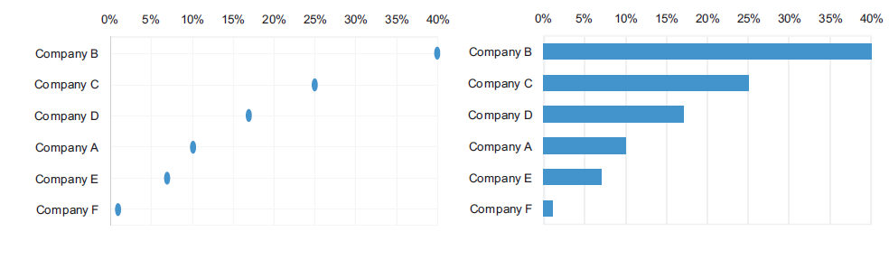
Pie Chart

Slide 26
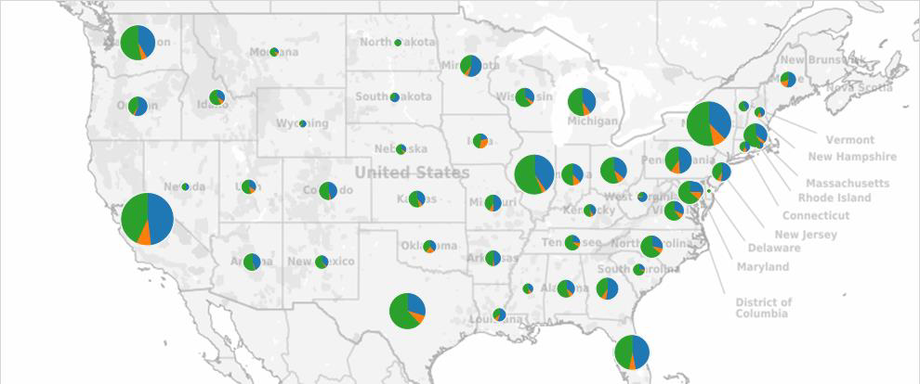
Pie Chart

Slide 27
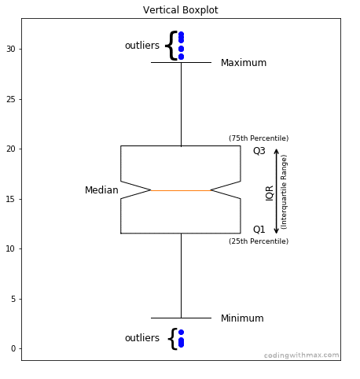
Box Plot (i.e. Box and Whisker Plot)
Mostly used for
•Distribution
•Range
•Outlier
•Large volumes of data
Notes:
https://math.stackexchange.com/questions/2491557/can-a-minimum-or-maximum-be-an-outlier

Slide 28
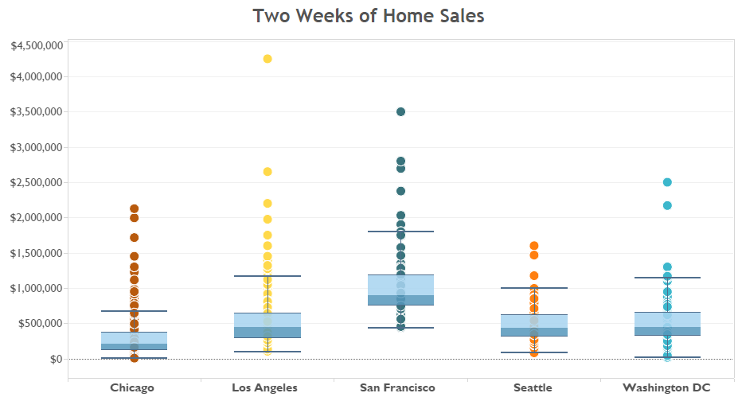
Box Plot
Notes:
https://math.stackexchange.com/questions/2491557/can-a-minimum-or-maximum-be-an-outlier

Slide 29
Choosing Charts based on Data Type
Date + One Measure
Business Stories :
Trend
Straightforward
Pattern
Sequence
Seasonality
Common Plots :
Lines

Slide 30
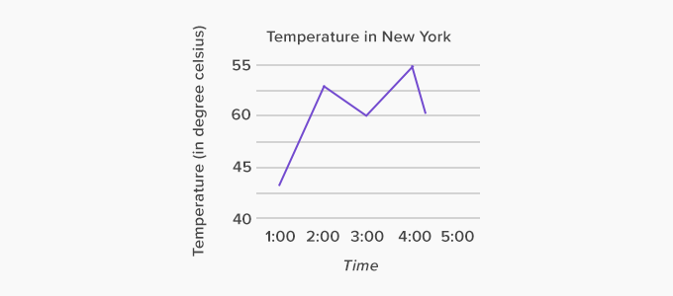
Line Graph

Slide 31
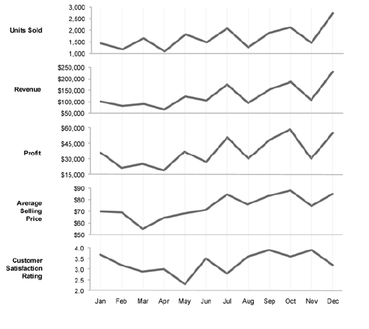
Stacked line graphs

Slide 32
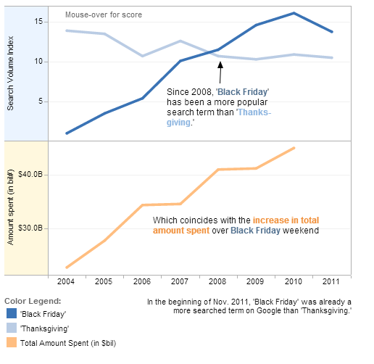
Stacked line graphs

Slide 33
Choosing Charts based on Data Type
Two Measure + One Dimension
Business Stories :
Distribution
Hierarchy
Common Plots :
Tree Map

Slide 34
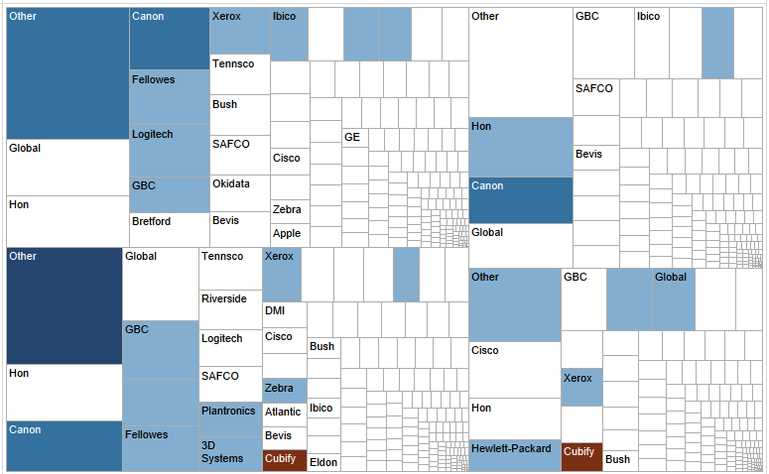

Tree Map

Slide 35
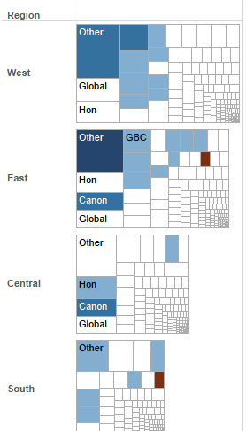
Tree Map

